Slide 1
POWER BI
1200functionalities 300+visuals bi mean business intelligence developed by Microsoft
Powerful tool compare to others
Business tool
3 months update version
Powerbi desktop available
Free and open source
Not supported in mac

Slide 2
EXPAND PAGE SIZE: Click view tab-> click page view->click fit width
FIELDS: here we can see the columns
VISUALIZATIONS: here we can see the all charts
FILTERS: it is sub filters like to get the top 10 datas ,100 datas etc.
can see the left side 3 icons
REPORT: the visualization report
DATA : can see the complete imported data
MODEL: make a relationship of all sheets

Slide 3
Make sure that your tableau is lates t version
If you share your data into others, sometimes get error due to the version issue.
And also make sure that the options are enabled.
Files-Option& settings-options-preview features-tick shapemap, modern visual, power bi desktop, modify visuals, sparklines, metrics visuals, field parameters-ok

Slide 4
Convert excel data into table for data analysis. This way is better than normal range data.
Click a value in excel and Press clt+t

Slide 5
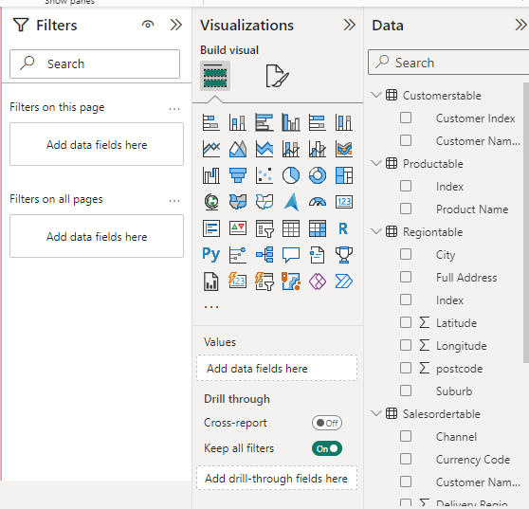
If you want to change
the background space colour
Click the ‘Build visual’ near ’format your
report page’-wallpaper-color

Slide 6
Choose required chart and you can see the x & y axis under the visualizing charts.
Select ‘channel’ column for y-axis, and ‘total revenue’ for x-axis from sales order.
Legend→ used to classify view the data. here we using currency code and drag it to the legend.
We can drag and drop and increase, decrease the size of the chart.

Slide 7
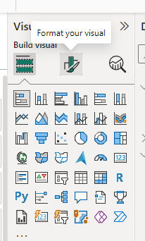
Format the chart: click the chart and get a icon
Click the format your visual icon.
Here you can off the X& Y axis & legend labels, change colours, font , size etc…
On the ‘data label’ you can see the how many data have in the labels.
On ‘total label’, it show the total data.
Change the title of the chart
click general-title-give new title.
Change chart background:
general-effect-backgroundcolor
Change the chart border:
general-effect-visual border-rounded border

Slide 8
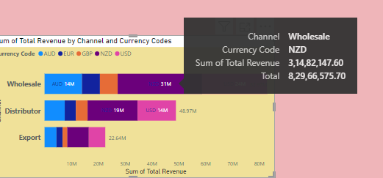
We can see if you point the mouse anywhere in the chart the data will popup. Use tooltip and off it.
general-tooltips-off
Note: on it because if it on it is helpful for the presentation.
Want to lock the chart in a specific area:
view-lock object.

Slide 9
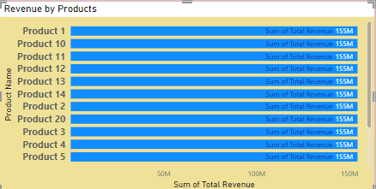
DATA MODELLING
Used to connect the different tables fields.
Delete the default connection(click the line and delete)
Drag the product table index and drop to the sales order table product description index, get the connection.
Drag customer index from customertable into customer name index of salestables.
Drag Regions index from regionstable into delivery
regions index of salestables.
This modelling used for , if we get the chart
as same data like this,

Slide 10
If you want rotate the chart, click the right more option icon, then click sort axis option and choose what you want.

Slide 11
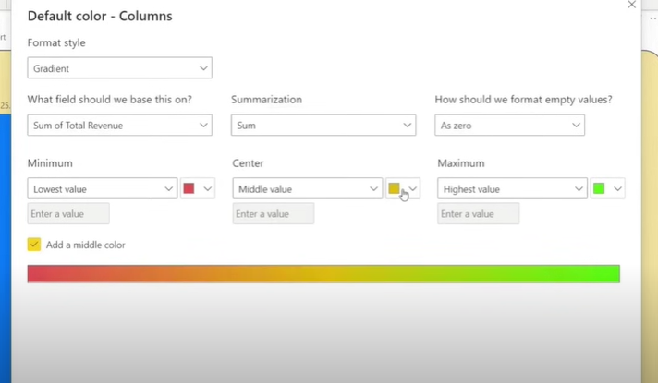
Want to change the chart every column different colour, click
‘format your visual’- visual- columns-click fx and edit like this

Slide 12
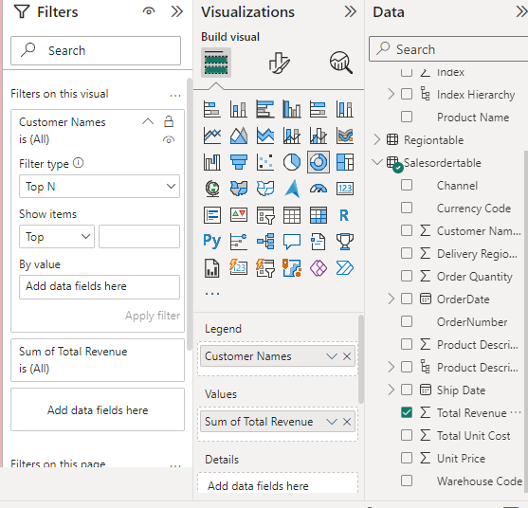
Top N filters

